Slide 1



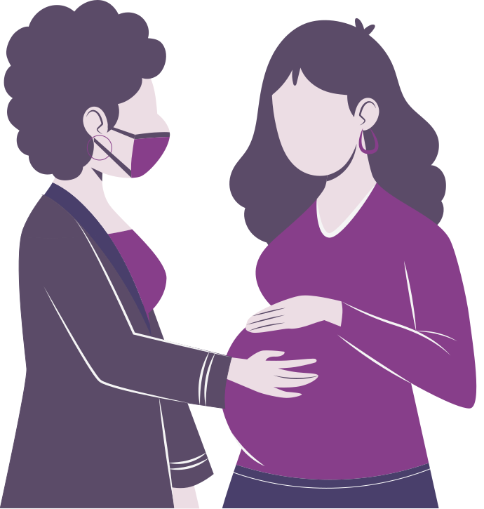



PRENATAL CARE IN MARYLAND

Slide 2
ATENCIÓN PRENATAL EN MARYLAND

Slide 3



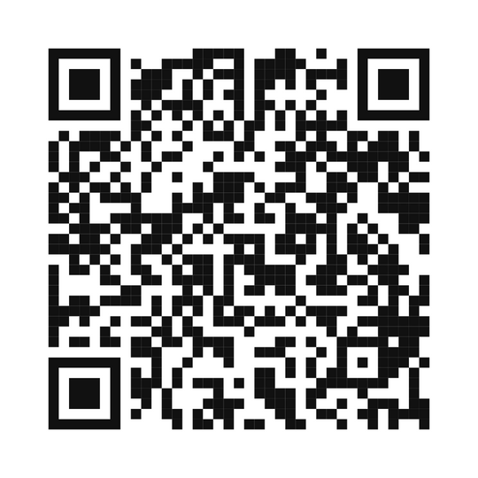







RESOURCES
RECURSOS
¡Síguenos en línea!
Conectémonos para nuestras últimas noticias y actualizaciones de recursos y eventos.
Twitter @cshmd_
Facebook @coachingsaludholistica
Instagram @coachingsaludholistica
LinkedIn Coaching Salud Holistica
OPEN YOUR PHONE CAMERA AND SCAN THIS QR CODE.
ABRE LA CÁMARA DE TU TELÉFONO Y ESCANEA ESTE CÓDIGO QR.
TikTok @coachingsaludholistica
Spotify Coaching Salud Holistica
Correo Electrónico: jhoselyn@coachingsaludholistica.org
Sito Web: www.coachingsaludholistica.com

Slide 4
RESOURCES
RECURSOS
Follow Us Online!
Let's connect for our latest news and updates on resources and events.
Twitter @cshmd_
Facebook @coachingsaludholistica
Instagram @coachingsaludholistica
LinkedIn Coaching Salud Holistica
TikTok @coachingsaludholistica
OPEN YOUR PHONE CAMERA AND SCAN THIS QR CODE.
ABRE LA CÁMARA DE TU TELÉFONO Y ESCANEA ESTE CÓDIGO QR.
Spotify Coaching Salud Holistica
Email: jhoselyn@coachingsaludholistica.org
Website: www.coachingsaludholistica.com

Slide 5


Agenda
  Guest Speaeker
  Facts about Maternal Health in the United States
  Providers to See When Pregnant
  Obtaining Medical Coverage for Prenatal Care and More
  Additional Resource Support

Slide 6
Agenda
  Datos sobre la salud materna en los Estados Unidos
  Proveedores a los que acudir durante el embarazo
  Obtención de cobertura médica para atención prenatal y más
  Soporte de recursos adicionales

Slide 7

Reproductive Health Care
Prenatal Care
Reproductive health is a state of complete physical, mental and social well-being and not only the absence of conditions or diseases, in everything related to the reproductive system and its functions and processes.
Prenatal care is medical care you get during pregnancy. At each visit, a health care provider checks on the parent and the growing baby. .
Benefits of recieveing reproductive healthcare allows us to test for cancer, menstrual pain or complications, sexually transmitted diseases, unwanted or complicated pregnancies, sexual violence.
True prenatal care begins before someone becomes pregnant through reproductive health care and primary care.

Slide 8
Atención de Salud Reproductiva
Cuidado Prenatal
La salud reproductiva es un estado de completo bienestar físico, mental y social y no sólo la ausencia de afecciones o enfermedades, en todo lo relacionado con el sistema reproductivo y sus funciones y procesos.
La atención prenatal es la atención médica que recibe durante el embarazo. En cada visita, un proveedor de atención médica controla a los padres y al bebé en crecimiento. .
Los beneficios de recibir atención médica reproductiva nos permiten realizar pruebas de cáncer, dolores o complicaciones menstruales, enfermedades de transmisión sexual, embarazos no deseados o complicados, violencia sexual.
La verdadera atención prenatal comienza antes de que alguien quede embarazada a través de la atención de salud reproductiva y la atención primaria.

Slide 9

The leading causes of maternal mortality worldwide are obstetric complications such as severe bleeding (postpartum hemorrhage), hypertensive disorders (eclampsia and pre-eclampsia), infections, unsafe abortion, and obstructed labor.
These causes are largely preventable with timely access to quality maternal healthcare services, including skilled birth attendance, emergency obstetric care, and postnatal care for mothers and newborns.
The Facts
Notes:
According to data from the Centers for Disease Control and Prevention (CDC), the maternal mortality ratio in the United States was 20.1 maternal deaths per 100,000 live births in 2019. This represents a total of 658 maternal deaths recorded in the United States that year.

Slide 10
Las principales causas de mortalidad materna en todo el mundo son las complicaciones obstétricas, como hemorragias graves (hemorragia posparto), trastornos hipertensivos (eclampsia y preeclampsia), infecciones, abortos inseguros y partos obstruidos.
Estas causas se pueden prevenir en gran medida con el acceso oportuno a servicios de atención de salud materna de calidad, incluida la asistencia calificada en el parto, la atención obstétrica de emergencia y la atención posnatal para madres y recién nacidos.
Los hechos
Notes:
According to data from the Centers for Disease Control and Prevention (CDC), the maternal mortality ratio in the United States was 20.1 maternal deaths per 100,000 live births in 2019. This represents a total of 658 maternal deaths recorded in the United States that year.

Slide 11
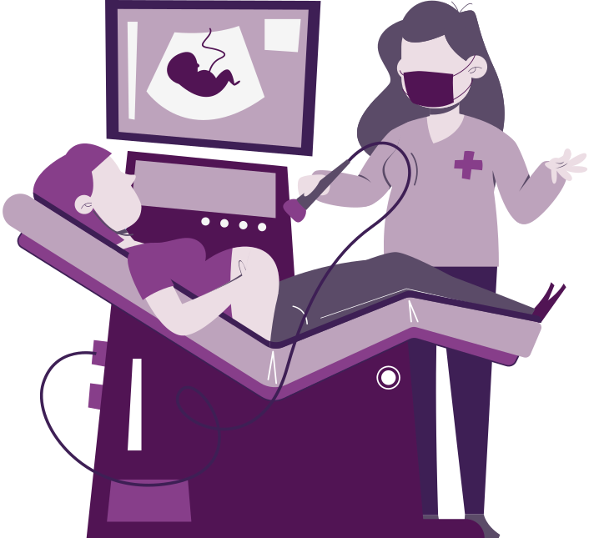
The Facts
According to the Centers for Disease Control and Prevention (CDC), in the United States, about 77.5% of pregnant women initiated prenatal care in the first trimester in 2019.
Giving birth costs $18,865 on average, including pregnancy, delivery and postpartum care, according to the Peterson-Kaiser Family Foundation (KFF) Health System Tracker
However, disparities exist among different racial and ethnic groups, with non-Hispanic Black and Hispanic women being less likely to receive early prenatal care compared to non-Hispanic White women.
Race and ethnicity are tied to different causes of maternal deaths. The leading causes for the following groups are:
  Black: Heart complications
  Native American: Severe bleeding
  Hispanic and Latino: Infection (Sepsis)
  White: Heart complications
  Asian: Severe bleeding
According to the CDC, in 2019, around 6.6% of women in the United States reported receiving late or no prenatal care.
Notes:
cial Disparities: Maternal mortality rates in the United States disproportionately affect women of color, particularly Black and Indigenous women. According to the CDC, Black women are more than three times as likely to die from pregnancy-related complications as White women, with a maternal mortality ratio of 44.0 deaths per 100,000 live births for Black women compared to 14.1 deaths per 100,000 live births for White women.
Causes of Maternal Deaths: The leading causes of maternal mortality in the United States include severe bleeding (hemorrhage), hypertensive disorders (such as preeclampsia and eclampsia), cardiovascular conditions, infection, and complications related to cesarean delivery. Mental health conditions, such as depression and substance use disorders, also contribute to maternal mortality and morbidity.
Postpartum Maternal Deaths: Postpartum maternal deaths, occurring within the first year after childbirth, have been a particular concern in the United States. Data suggests that a significant proportion of maternal deaths occur during the postpartum period, highlighting the importance of comprehensive postpartum care and follow-up for new mothers.

Slide 12
Los hechos
Según los Centros para el Control y la Prevención de Enfermedades (CDC), en Estados Unidos, alrededor del 77,5% de las mujeres embarazadas iniciaron la atención prenatal en el primer trimestre en 2019.
Dar a luz cuesta $18,865 en promedio, incluyendo el embarazo, el parto y la atención posparto, según Peterson-Kaiser Family Foundation (KFF) Health System Tracker.
Sin embargo, existen disparidades entre los diferentes grupos raciales y étnicos, y las mujeres hispanas y negras no hispanas tienen menos probabilidades de recibir atención prenatal temprana en comparación con las mujeres blancas no hispanas.
La raza y el origen étnico están vinculados a diferentes causas de muerte materna. Las principales causas de los siguientes grupos son:
  Negro: complicaciones cardíacas
  Nativo americano: sangrado severo
  Hispanos y latinos: infección (sepsis)
  Blanco: complicaciones cardíacas
  Asiático: sangrado severo
Según los CDC, en 2019, alrededor del 6,6% de las mujeres en los Estados Unidos informaron haber recibido atención prenatal tardía o nula.
Notes:
cial Disparities: Maternal mortality rates in the United States disproportionately affect women of color, particularly Black and Indigenous women. According to the CDC, Black women are more than three times as likely to die from pregnancy-related complications as White women, with a maternal mortality ratio of 44.0 deaths per 100,000 live births for Black women compared to 14.1 deaths per 100,000 live births for White women.
Causes of Maternal Deaths: The leading causes of maternal mortality in the United States include severe bleeding (hemorrhage), hypertensive disorders (such as preeclampsia and eclampsia), cardiovascular conditions, infection, and complications related to cesarean delivery. Mental health conditions, such as depression and substance use disorders, also contribute to maternal mortality and morbidity.
Postpartum Maternal Deaths: Postpartum maternal deaths, occurring within the first year after childbirth, have been a particular concern in the United States. Data suggests that a significant proportion of maternal deaths occur during the postpartum period, highlighting the importance of comprehensive postpartum care and follow-up for new mothers.

Slide 13



LGBTQ+ and Pregnancy
  People who identify as LGBTQ+, or lesbian, gay, bisexual, transgender, or queer/questioning, can have healthy pregnancies and babies through multiple routes of conception. However, they may face challenges that affect their health and pregnancies.
  Pregnancy is usually focused on women. But not all people who are pregnant identify as women. Your gender identity may be different from your sex assigned at birth.
    Regardless of gender or identity, prenatal care is essential for everyone who is pregnant.
Notes:
2 MIN
Los estudios muestran que las tasas de depresión posparto tienden a ser más altas en familias LGBTQ+. Los adultos LGBTQ+ tienen una mayor probabilidad de experimentar una condición de salud mental que los adultos heterosexuales. Los factores de riesgo de los trastornos de ansiedad y posparto pueden estar relacionados con el embarazo y la pérdida del bebé, o el parto prematuro.

Slide 14
LGBTQ+ y el Embarazo
  Las personas que se identifican como LGBTQ+, o lesbianas, gays, bisexuales, transgénero o queer/cuestionantes, pueden tener embarazos y bebés saludables a través de múltiples vías de concepción. Sin embargo, pueden enfrentar desafíos que afectan su salud y sus embarazos.
  El embarazo suele centrarse en las mujeres. Pero no todas las personas que están embarazadas se identifican como mujeres. Su identidad de género puede ser diferente de su sexo asignado al nacer.
    Independientemente del género o la identidad, la atención prenatal es esencial para todos/as embarazadas/os.
Notes:
2 MIN
Los estudios muestran que las tasas de depresión posparto tienden a ser más altas en familias LGBTQ+. Los adultos LGBTQ+ tienen una mayor probabilidad de experimentar una condición de salud mental que los adultos heterosexuales. Los factores de riesgo de los trastornos de ansiedad y posparto pueden estar relacionados con el embarazo y la pérdida del bebé, o el parto prematuro.

Slide 15


Overturning Roe v Wade and the Impact on Maternal Health
  On June 24, 2022, the Supreme Court overturned Roe v. Wade, the landmark 1973 decision that made abortion access in the United States a constitutional right, leaving the legality of abortion in the hands of individual states.
  As a result of the rollback, many states have taken steps to ban or restrict the procedure, and abortion access in the United States continues to evolve.
  This change has made access to prenatal care and contraception much more important.
Notes:
2 MIN
Los estudios muestran que las tasas de depresión posparto tienden a ser más altas en familias LGBTQ+. Los adultos LGBTQ+ tienen una mayor probabilidad de experimentar una condición de salud mental que los adultos heterosexuales. Los factores de riesgo de los trastornos de ansiedad y posparto pueden estar relacionados con el embarazo y la pérdida del bebé, o el parto prematuro.

Slide 16
Anulación del Caso Roe v Wade y el Impacto a la Salud Materna
  El 24 de junio de 2022, la Corte Suprema anuló Roe v. Wade, la histórica decisión de 1973 que convirtió el acceso al aborto en Estados Unidos en un derecho constitucional, dejando la legalidad del aborto en manos de los estados individuales.
  Como resultado de la reversión, muchos estados han tomado medidas para prohibir o restringir el procedimiento, y el acceso al aborto en Estados Unidos continúa evolucionando.
  Este cambio ha hecho que el acceso a la atención prenatal y a los anticonceptivos sea mucho más importante.
Notes:
2 MIN
Los estudios muestran que las tasas de depresión posparto tienden a ser más altas en familias LGBTQ+. Los adultos LGBTQ+ tienen una mayor probabilidad de experimentar una condición de salud mental que los adultos heterosexuales. Los factores de riesgo de los trastornos de ansiedad y posparto pueden estar relacionados con el embarazo y la pérdida del bebé, o el parto prematuro.

Slide 17


Why does it matter?
  In Maryland, maternal mortality and severe maternal morbidity are consistently higher than national averages.
  Each year, approximately 1,500 mothers experience a life-threatening pregnancy or childbirth complication.
  Unintentional drug overdose has been the leading cause of death in the year following pregnancy for five consecutive years.
  More than 80% of maternal deaths are preventable or potentially preventable.
Notes:
1 MIN
Los estudios muestran que las tasas de depresión posparto tienden a ser más altas en familias LGBTQ+. Los adultos LGBTQ+ tienen una mayor probabilidad de experimentar una condición de salud mental que los adultos heterosexuales. Los factores de riesgo de los trastornos de ansiedad y posparto pueden estar relacionados con el embarazo y la pérdida del bebé, o el parto prematuro.

Slide 18
¿Por qué importa?
  En Maryland, la mortalidad materna y la morbilidad materna grave son consistentemente más altas que los promedios nacionales.
  Cada año, aproximadamente 1,500 madres experimentan una complicación del embarazo o del parto que pone en peligro su vida.
  La sobredosis involuntaria de drogas ha sido la principal causa de muerte en el año siguiente al embarazo durante cinco años consecutivos.
  Más del 80% de las muertes maternas son prevenibles o potencialmente prevenibles.
Notes:
1 MIN
Los estudios muestran que las tasas de depresión posparto tienden a ser más altas en familias LGBTQ+. Los adultos LGBTQ+ tienen una mayor probabilidad de experimentar una condición de salud mental que los adultos heterosexuales. Los factores de riesgo de los trastornos de ansiedad y posparto pueden estar relacionados con el embarazo y la pérdida del bebé, o el parto prematuro.

Slide 19



Medical Providers to See When Pregnant
Obstetrician: Medical professionals specialized in pregnancy, childbirth, and postpartum care.
Midwife: Healthcare professionals trained in assisting women during pregnancy, childbirth, and the postpartum period﻿. They can provide prenatal care, attend to labor and delivery, and offer support for breastfeeding and newborn care.
Primary Care Provider: Pregnant individuals who have pre-existing medical conditions, such as diabetes, hypertension, or asthma, may benefit from continued care from their primary care provider (PCP) alongside prenatal care from an obstetrician or midwife.
Notes:
Obstetrician or Midwife: Obstetricians are medical doctors specialized in pregnancy, childbirth, and postpartum care. They provide prenatal care, monitor the progress of the pregnancy, manage any pregnancy-related complications, and oversee the labor and delivery process. Midwives, on the other hand, are healthcare professionals trained in assisting women during pregnancy, childbirth, and the postpartum period. They can provide prenatal care, attend to labor and delivery, and offer support for breastfeeding and newborn care. Both obstetricians and midwives play crucial roles in providing personalized care and guidance throughout pregnancy.
Primary Care Provider: Pregnant individuals who have pre-existing medical conditions, such as diabetes, hypertension, or asthma, may benefit from continued care from their primary care provider (PCP) alongside prenatal care from an obstetrician or midwife. PCPs can help manage chronic health conditions and coordinate care with other specialists to ensure optimal health outcomes for both the mother and the baby.
Maternal-Fetal Medicine Specialist: Maternal-fetal medicine (MFM) specialists are obstetricians with advanced training in managing high-risk pregnancies and maternal medical complications. They provide specialized care for pregnant individuals with complex medical conditions, multiple gestations (twins, triplets, etc.), or pregnancies at increased risk of complications. MFM specialists work closely with obstetricians, midwives, and other healthcare providers to develop individualized care plans and optimize outcomes for high-risk pregnancies.
Genetic Counselor: Genetic counselors specialize in assessing the risk of inherited genetic disorders and birth defects in families. They provide information, counseling, and genetic testing options to pregnant individuals and their partners who may be at increased risk of having a child with a genetic condition. Genetic counselors help individuals make informed decisions about prenatal testing, screening, and potential treatment options based on their family history and genetic risk factors.
Dietitian or Nutritionist: Nutrition plays a crucial role in supporting a healthy pregnancy and fetal development. Dietitians or nutritionists can provide personalized guidance on maintaining a balanced diet, managing weight gain, and addressing specific nutritional needs during pregnancy, such as folic acid, iron, calcium, and omega-3 fatty acids. They can also offer support for managing pregnancy-related conditions like gestational diabetes or preeclampsia through dietary modifications.

Slide 20
Proveedores médicos a los que acudir durante el embarazo
Obstetra: Profesionales médicos especializados en la atención del embarazo, parto y posparto.
Partera: Profesionales de la salud capacitados para asistir a la mujer durante el embarazo, parto y puerperio. Pueden brindar atención prenatal, atender el parto y ofrecer apoyo para la lactancia y el cuidado del recién nacido.
Proveedor de atención primaria: las personas embarazadas que tienen afecciones médicas preexistentes, como diabetes, hipertensión o asma, pueden beneficiarse de la atención continua de su proveedor de atención primaria (PCP), junto con la atención prenatal de un obstetra o una partera.
Notes:
Obstetrician or Midwife: Obstetricians are medical doctors specialized in pregnancy, childbirth, and postpartum care. They provide prenatal care, monitor the progress of the pregnancy, manage any pregnancy-related complications, and oversee the labor and delivery process. Midwives, on the other hand, are healthcare professionals trained in assisting women during pregnancy, childbirth, and the postpartum period. They can provide prenatal care, attend to labor and delivery, and offer support for breastfeeding and newborn care. Both obstetricians and midwives play crucial roles in providing personalized care and guidance throughout pregnancy.
Primary Care Provider: Pregnant individuals who have pre-existing medical conditions, such as diabetes, hypertension, or asthma, may benefit from continued care from their primary care provider (PCP) alongside prenatal care from an obstetrician or midwife. PCPs can help manage chronic health conditions and coordinate care with other specialists to ensure optimal health outcomes for both the mother and the baby.
Maternal-Fetal Medicine Specialist: Maternal-fetal medicine (MFM) specialists are obstetricians with advanced training in managing high-risk pregnancies and maternal medical complications. They provide specialized care for pregnant individuals with complex medical conditions, multiple gestations (twins, triplets, etc.), or pregnancies at increased risk of complications. MFM specialists work closely with obstetricians, midwives, and other healthcare providers to develop individualized care plans and optimize outcomes for high-risk pregnancies.
Genetic Counselor: Genetic counselors specialize in assessing the risk of inherited genetic disorders and birth defects in families. They provide information, counseling, and genetic testing options to pregnant individuals and their partners who may be at increased risk of having a child with a genetic condition. Genetic counselors help individuals make informed decisions about prenatal testing, screening, and potential treatment options based on their family history and genetic risk factors.
Dietitian or Nutritionist: Nutrition plays a crucial role in supporting a healthy pregnancy and fetal development. Dietitians or nutritionists can provide personalized guidance on maintaining a balanced diet, managing weight gain, and addressing specific nutritional needs during pregnancy, such as folic acid, iron, calcium, and omega-3 fatty acids. They can also offer support for managing pregnancy-related conditions like gestational diabetes or preeclampsia through dietary modifications.

Slide 21
Medical Providers to See When Pregnant
Maternal-Fetal Medicine Specialist: Specialists are obstetricians with advanced training in managing high-risk pregnancies and maternal medical complications. They provide specialized care for pregnant individuals with complex medical conditions, multiple gestations (twins, triplets, etc.), or pregnancies at increased risk of complications.
Dietitian or Nutritionist: Can provide personalized guidance on maintaining a balanced diet, managing weight gain, and addressing specific nutritional needs during pregnancy, such as folic acid, iron, calcium, and omega-3 fatty acids and provide personalized guidance on maintaining a balanced diet, managing weight gain, and addressing specific nutritional needs during pregnancy.
Notes:
Maternal-Fetal Medicine Specialist: Maternal-fetal medicine (MFM) specialists are obstetricians with advanced training in managing high-risk pregnancies and maternal medical complications. They provide specialized care for pregnant individuals with complex medical conditions, multiple gestations (twins, triplets, etc.), or pregnancies at increased risk of complications. MFM specialists work closely with obstetricians, midwives, and other healthcare providers to develop individualized care plans and optimize outcomes for high-risk pregnancies.
Genetic Counselor: Genetic counselors specialize in assessing the risk of inherited genetic disorders and birth defects in families. They provide information, counseling, and genetic testing options to pregnant individuals and their partners who may be at increased risk of having a child with a genetic condition. Genetic counselors help individuals make informed decisions about prenatal testing, screening, and potential treatment options based on their family history and genetic risk factors.
Dietitian or Nutritionist: Nutrition plays a crucial role in supporting a healthy pregnancy and fetal development. Dietitians or nutritionists can provide personalized guidance on maintaining a balanced diet, managing weight gain, and addressing specific nutritional needs during pregnancy, such as folic acid, iron, calcium, and omega-3 fatty acids. They can also offer support for managing pregnancy-related conditions like gestational diabetes or preeclampsia through dietary modifications.

Slide 22
Proveedores médicos a los que acudir durante el embarazo
Especialista en Medicina Materno-Fetal: Los especialistas son obstetras con capacitación avanzada en el manejo de embarazos de alto riesgo y complicaciones médicas maternas. Brindan atención especializada a personas embarazadas con afecciones médicas complejas, gestaciones múltiples (gemelos, trillizos, etc.) o embarazos con mayor riesgo de complicaciones.
Dietista o Nutricionista: Puede brindar orientación personalizada sobre cómo mantener una dieta equilibrada, controlar el aumento de peso y abordar necesidades nutricionales específicas durante el embarazo, como ácido fólico, hierro, calcio y ácidos grasos omega-3, y brindar orientación personalizada sobre cómo mantener una dieta equilibrada. , controlar el aumento de peso y abordar las necesidades nutricionales específicas durante el embarazo.
Notes:
Maternal-Fetal Medicine Specialist: Maternal-fetal medicine (MFM) specialists are obstetricians with advanced training in managing high-risk pregnancies and maternal medical complications. They provide specialized care for pregnant individuals with complex medical conditions, multiple gestations (twins, triplets, etc.), or pregnancies at increased risk of complications. MFM specialists work closely with obstetricians, midwives, and other healthcare providers to develop individualized care plans and optimize outcomes for high-risk pregnancies.
Genetic Counselor: Genetic counselors specialize in assessing the risk of inherited genetic disorders and birth defects in families. They provide information, counseling, and genetic testing options to pregnant individuals and their partners who may be at increased risk of having a child with a genetic condition. Genetic counselors help individuals make informed decisions about prenatal testing, screening, and potential treatment options based on their family history and genetic risk factors.
Dietitian or Nutritionist: Nutrition plays a crucial role in supporting a healthy pregnancy and fetal development. Dietitians or nutritionists can provide personalized guidance on maintaining a balanced diet, managing weight gain, and addressing specific nutritional needs during pregnancy, such as folic acid, iron, calcium, and omega-3 fatty acids. They can also offer support for managing pregnancy-related conditions like gestational diabetes or preeclampsia through dietary modifications.

Slide 23

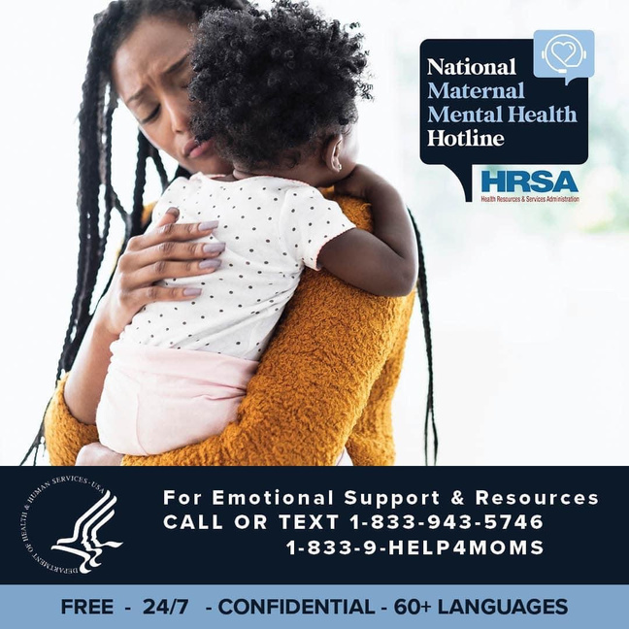
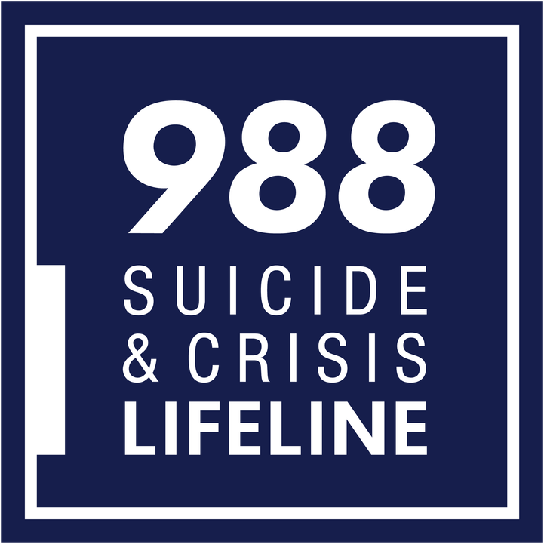
Medical Providers to See When Pregnant
Perinatal Mental Health Specialist: Perinatal mental health specialists, such as psychologists, psychiatrists, or licensed clinical social workers, specialize in addressing mental health concerns during pregnancy and the postpartum period.
Notes:
Perinatal Mental Health Specialist: Perinatal mental health specialists, such as psychologists, psychiatrists, or licensed clinical social workers, specialize in addressing mental health concerns during pregnancy and the postpartum period. They provide assessment, counseling, and treatment for mood disorders (e.g., depression, anxiety), adjustment difficulties, trauma, and other emotional challenges that may arise during pregnancy or after childbirth. Perinatal mental health specialists work collaboratively with obstetricians, midwives, and other healthcare providers to support the psychological well-being of pregnant individuals and their families.

Slide 24
Proveedores médicos a los que acudir durante el embarazo
Especialista en salud mental perinatal: Son especialistas en salud mental perinatal, como psicólogos, psiquiatras o trabajadores sociales clínicos autorizados, se especializan en abordar problemas de salud mental durante el embarazo y el período posparto.
Notes:
Perinatal Mental Health Specialist: Perinatal mental health specialists, such as psychologists, psychiatrists, or licensed clinical social workers, specialize in addressing mental health concerns during pregnancy and the postpartum period. They provide assessment, counseling, and treatment for mood disorders (e.g., depression, anxiety), adjustment difficulties, trauma, and other emotional challenges that may arise during pregnancy or after childbirth. Perinatal mental health specialists work collaboratively with obstetricians, midwives, and other healthcare providers to support the psychological well-being of pregnant individuals and their families.

Slide 25
Other Providers to See When Pregnant and After Delivery
Notes:
Doula
Lactation Consultant
Obstetric physical therapist
Community health workers

Slide 26
Otros proveedores para consultar durante el embarazo y después del parto
Notes:
Doula
Lactation Consultant
Obstetric physical therapist
Community health workers

Slide 27
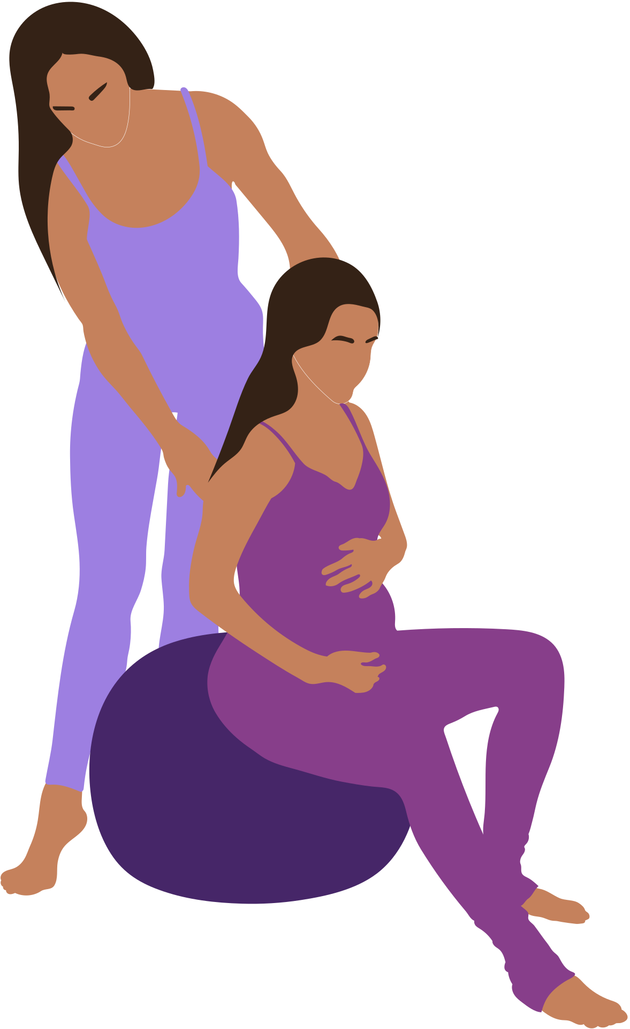
Doulas
  A doula is a professional who is specifically trained in labor and childbirth support. Your doula is there alongside your doctor and nurses to help ensure your emotional and physical needs are being met. You hire a doula yourself and pay their fee out of pocket or through your insurance.
    Call your insurance to learn more about how coverage for doula services.
  There are different types of doulas but most are either birth doula and/or postpartum doula. Not all doulas are certified, to find certified doulas in Maryland please visit:
    DONA International: https://www.dona.org/what-is-a-doula-2/find-a-doula/
    ICEA: https://icea.org/directory/
    COMING SOON TO COACHING SALUD HOLISTICA IN ENGLISH AND SPANISH

Slide 28
Doulas
  Una doula es una profesional que está específicamente capacitada en apoyo al parto y al parto. Su doula está ahí junto con su médico y enfermeras para ayudar a garantizar que se satisfagan sus necesidades emocionales y físicas. Usted mismo contrata a una doula y paga sus honorarios de su bolsillo o mediante su seguro.
    Llame a su seguro para obtener más información sobre la cobertura de los servicios de doula.
  Hay diferentes tipos de doulas, pero la mayoría son doulas de parto y/o doulas posparto. No todas las doulas están certificadas; para encontrar doulas certificadas en Maryland, visite:
    DONA Internacional: https://www.dona.org/what-is-a-doula-2/find-a-doula/
    ICEA: https://icea.org/directory/
    PRÓXIMAMENTE COACHING SALUD HOLISTICA EN INGLÉS Y ESPAÑOL

Slide 29

Childbirth Educators
  Childbirth educators are professional sources of information, with skills to support for parents as they prepare for pregnancy, labor, birth, and parenthood. You may hire a childbirth educator yourself and pay their fee out of pocket or through your insurance.
    Call your insurance to learn more about how coverage for childbirth education.
  Not all childbirth educators are certified, to find certified childbirth educators in Maryland please visit:
    DONA International: https://www.dona.org/what-is-a-doula-2/find-a-doula/
    ICEA: https://icea.org/directory/
    Coaching Salud Holistica (fluent in English and Spanish): https://www.coachingsaludholistica.com/pregnancycoaching
Notes:
childbirth educators
as professional sources of information, with
skills to support for parents as they prepare for
pregnancy, labor, birth, and parenthood.

Slide 30
Educadores de Parto
  Los educadores de parto son fuentes profesionales de información, con habilidades para apoyar a los padres mientras se preparan para el embarazo, el parto, el nacimiento y la paternidad. Usted puede contratar a un educador de parto usted mismo y pagar sus honorarios de su bolsillo o a través de su seguro.
    Llame a su seguro para obtener más información sobre cómo cubre la educación sobre el parto.
  No todos los educadores de parto están certificados; para encontrar educadores de parto certificados en Maryland, visite:
    DONA Internacional: https://www.dona.org/what-is-a-doula-2/find-a-doula/
    ICEA: https://icea.org/directory/
    Coaching Salud Holistica (fluido en inglés y español): https://www.coachingsaludholistica.com/pregnancycoaching
Notes:
childbirth educators
as professional sources of information, with
skills to support for parents as they prepare for
pregnancy, labor, birth, and parenthood.

Slide 31

Lactation Consultants
  Lactation consultants or lactation specialists are nursing professionals who help new moms in their efforts to breastfeed. They also provide prenatal education and preparation for expecting parents.
  Anyone can call themselves a "lactation consultant", but it's best to find one who is certified as an International Board Certified Lactation Consultant (IBCLC). Covered by most insurances.
  A lactation consultant can help you navigate any number of new baby feeding challenges, including:
    Poor milk supply
    Trouble hitting weight milestones
    Struggles with finding the right nursing position, especially after a C-section
    Baby falling asleep at the breast
    Baby refusing to breastfeed
    Pain while breastfeeding
    And more

Slide 32
Consultores de Lactancia
  Los consultores en lactancia o especialistas en lactancia son profesionales de enfermería que ayudan a las nuevas mamás en sus esfuerzos por amamantar. También brindan educación prenatal y preparación para los futuros padres.
  Cualquiera puede llamarse "consultor de lactancia", pero es mejor encontrar uno que esté certificado como Consultor de Lactancia Certificado por la Junta Internacional (IBCLC). Cubierto por la mayoría de los seguros.
  Un asesor en lactancia puede ayudarla a superar cualquier cantidad de nuevos desafíos en la alimentación del bebé, que incluyen:
    Escaso suministro de leche
    Problemas para alcanzar los objetivos de peso
    Tiene dificultades para encontrar la posición adecuada para amamantar, especialmente después de una cesárea
    Bebé que se queda dormido en el pecho
    Bebé que se niega a amamantar
    Dolor durante la lactancia
    Y más

Slide 33

Physical Therapists
  Pregnancy physical therapy can be useful for remedying common discomforts like back pain or for enhancing your body’s ability to have a smoother pregnancy and birth. Physical therapy is not just for recovery.
    Talk to your health care provider about incorporating physical therapy into your prenatal care.
  Physical therapists can help you patients gain strength in the back, abs, and hips, which will help you during the delivery process and will also be beneficial for recovery. PTs can recommend optimal positions for labor and delivery.
  Insurance can cover these costs.

Slide 34
Fisioterapeutas
  La fisioterapia durante el embarazo puede ser útil para remediar molestias comunes como el dolor de espalda o para mejorar la capacidad de su cuerpo para tener un embarazo y un parto más tranquilos. La fisioterapia no es sólo para la recuperación.
    Hable con su proveedor de atención médica sobre la incorporación de fisioterapia a su atención prenatal.
  Los fisioterapeutas pueden ayudar a sus pacientes a ganar fuerza en la espalda, los abdominales y las caderas, lo que les ayudará durante el proceso del parto y también será beneficioso para la recuperación. Los fisioterapeutas pueden recomendar posiciones óptimas para el trabajo de parto y el parto.
  El seguro puede cubrir estos costos.

Slide 35

Dentist
  Pregnancy increases the risk of certain dental health problems that may lead to pregnancy complications, like premature birth.
  You can have dental treatment any time during pregnancy. If it’s elective treatment (treatment that you don’t need immediately right away and isn’t necessary to protect your health or your baby’s health), try to schedule it in the second trimester or even after you deliver.
  Insurance can cover these costs.
Notes:
Example: If you have vomiting from morning sickness, your teeth may be exposed to too much stomach acid. This acid can harm the enamel (the hard surface) of your teeth. Morning sickness (also called nausea and vomiting of pregnancy or NVP) is nausea and vomiting that happens during pregnancy, usually in the first few months.

Slide 36
Dentista
  El embarazo aumenta el riesgo de ciertos problemas de salud dental que pueden provocar complicaciones en el embarazo, como el parto prematuro.
  Puede recibir tratamiento dental en cualquier momento durante el embarazo. Si se trata de un tratamiento electivo (tratamiento que no necesita inmediatamente y que no es necesario para proteger su salud o la de su bebé), intente programarlo en el segundo trimestre o incluso después del parto.
  El seguro puede cubrir estos costos.
Notes:
Example: If you have vomiting from morning sickness, your teeth may be exposed to too much stomach acid. This acid can harm the enamel (the hard surface) of your teeth. Morning sickness (also called nausea and vomiting of pregnancy or NVP) is nausea and vomiting that happens during pregnancy, usually in the first few months.

Slide 37
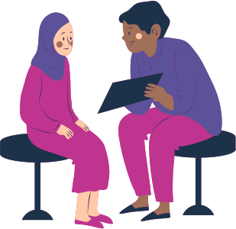
Community Health Workers and Social Workers
  Perinatal social workers work to support women and families as they navigate medical challenges, process complex information about pregnancies and neonates (birth to age 1), and access community supports. Perinatal social workers help with planning and nurture hope as families move toward their future.
  Community health workers identify pregnant women, helping diagnose existing and pregnancy-related conditions, promoting health, preventing disease and treating minor health conditions in pregnant women, and can build access to resources.
  Insurance can sometimes cover these costs, but local department of health and social services can provide these services for free.

Slide 38
Promotores de Salud y Trabajadores Sociales
  Los trabajadores sociales perinatales trabajan para apoyar a las mujeres y las familias mientras enfrentan desafíos médicos, procesan información compleja sobre embarazos y recién nacidos (desde el nacimiento hasta el año de edad) y acceden a apoyos comunitarios. Los trabajadores sociales perinatales ayudan con la planificación y alimentan la esperanza a medida que las familias avanzan hacia su futuro.
  Los promotores de salud identifican a las mujeres embarazadas, ayudan a diagnosticar afecciones existentes y relacionadas con el embarazo, promueven la salud, previenen enfermedades y tratan afecciones de salud menores en mujeres embarazadas, y pueden generar acceso a recursos.
  A veces, el seguro puede cubrir estos costos, pero el departamento local de servicios sociales y de salud puede brindar estos servicios de forma gratuita.

Slide 39

MEDICAL COVERAGE
Notes:
Medicaid
Healthy Babies Equity Act
How to find a provider
What insurance covers: lactation consultant, breast pump, doula, birth control, labor and delivery, medical transportation (metroaccess)
https://www.marchofdimes.org/find-support/topics/planning-baby/health-insurance-during-pregnancy

Slide 40
  COBERTURA MÉDICA
Notes:
Medicaid
Healthy Babies Equity Act
How to find a provider
What insurance covers: lactation consultant, breast pump, doula, birth control, labor and delivery, medical transportation (metroaccess)
https://www.marchofdimes.org/find-support/topics/planning-baby/health-insurance-during-pregnancy

Slide 41

"I'M PREGNANT, NOW WHAT?"
STEP ONE
STEP FOUR
Keep track of how far along you are to your best ability – when was your last period?
Access any additional resources you may need.
SECOND STEP
Make an appointment with an OB/GYN or visit a local pregnancy or women's center to discuss the best next steps for you. Pregnancy and women's centers offer low-cost services for those without insurance.
STEP THREE
Follow up with all necessary appointments after following up with a provider.
Notes:
1 MIN

Slide 42
"ESTOY EMBARAZADA, ¿AHORA QUÉ?"
PASO UNO
PASO CUATRO
Haga un seguimiento de su mejor capacidad de cuánto tiempo está - ¿cuándo fue su último período?
Acceda a cualquier recurso adicional que pueda necesitar.
SEGUNDO PASO
Haga una cita con un obstetra/ginecólogo o visite un centro local de embarazo o de mujeres para analizar los mejores pasos a seguir para usted. Los centros de embarazo y mujeres ofrecen servicios a bajo costo para quienes no tienen seguro.
PASO TRES
Haga un seguimiento con todas las citas necesarias después de hacer un seguimiento con un proveedor.
Notes:
1 MIN

Slide 43

ACCESS PRENATAL CARE
  IF YOU HAVE INSURANCE, CONTACT YOUR INSURANCE TO FIND AN OBSTETRICIAN.
  IF YOU DO NOT HAVE INSURANCE, VISIT:
    LOCAL PREGNANCY CENTERS/WOMEN'S CENTERS
    COMMUNITY CLINICS
    DEPARTMENT OF HEALTH/SOCIAL SERVICES
THERE ARE SEVERAL COMMUNITY RESOURCES TO HELP ACCESS PRENATAL HEALTH AND WELLNESS SERVICES.

Slide 44
ACCEDER A LA ATENCIÓN PRENATAL
  SI TIENE SEGURO, COMUNÍQUESE CON SU SEGURO PARA ENCONTRAR UN OBSTETRA.
  Si no tiene seguro, visite:
    Centros locales de embarazo/centros para mujeres
    Clínicas comunitarias
    Departamento de salud/Servicios sociales
HAY VARIOS RECURSOS COMUNITARIOS PARA AYUDAR A ACCEDER A LOS SERVICIOS DE SALUD Y BIENESTAR PRENATALES.

Slide 45


ACCESS PRENATAL CARE WITHOUT INSURANCE
  Maryland Health Connection is the health insurance marketplace in the state of Maryland, USA, created under the Patient Protection and Affordable Care Act.
  The marketplace is offered to individuals and families who are not covered by their employers and/or have low income.

Slide 46
ACCEDER ATENCIÓN PRENATAL SIN SEGURO
  Maryland Health Connection es el mercado de seguros de salud en el estado de Maryland, EE. UU., creado bajo la Ley de Protección al Paciente y Cuidado de Salud Asequible.
  El mercado se ofrece a personas y familias que no están cubiertas por sus empleadores y/o tienen bajos ingresos.

Slide 47




If you are a US resident or citizen
You may be eligible for Medicaid for prenatal and postpartum coverage based on income requirements. Must live in Maryland. Contact Maryland Health Connections today to apply. Sign up for Medicaid as soon as you know you are pregnant.

Slide 48
Si es residente o ciudadano estadounidense
Puede ser elegible para Medicaid para la cobertura prenatal y posparto según los requisitos de ingresos. Debe vivir en Maryland. Comuníquese con Maryland Health Connections hoy para presentar su solicitud. Inscríbase en Medicaid tan pronto como sepa que está embarazada.

Slide 49
If you are not a US resident or citizen
Beginning July 1, 2023, people who live in Maryland and are not U.S. residents or citizens may qualify for Medicaid coverage for prenatal and postpartum care based on income requirements. Contact Maryland Health Connections today to apply. Sign up for Medicaid as soon as you know you are pregnant.

Slide 50
Si es no es residente o ciudadana estadounidense
A partir del 1 de julio de 2023, las personas que vivan en Maryland y no sean residentes o ciudadanos estadounidenses pueden calificar para la cobertura de Medicaid para atención prenatal y posparto según los requisitos de ingresos. Comuníquese con Maryland Health Connections hoy para presentar su solicitud. Inscríbase en Medicaid tan pronto como sepa que está embarazada.

Slide 51


NECESSARY DOCUMENTS
  Birthdate
  Social Security numbers (or document numbers for legal immigrants)
  Proof of citizenship or immigration status
  Tax returns from previous years
  Employer and income information (pay stubs, W-2)
  Policy numbers of any current health insurance
  Information about any work-related coverage for which you or someone in your household may qualify
  Photo ID, to apply in person
ACCESS PRENATAL CARE WITHOUT INSURANCE
VISIT YOUR LOCAL HEALTH DEPARTMENT OR CALL MARYLAND HEALTH CONNECTIONS

Slide 52
DOCUMENTOS NECESARIOS
  Fecha de nacimiento
  Números de Seguro Social (o números de documento para inmigrantes legales)
  Prueba de ciudadanía o estatus migratorio
  Declaraciones de impuestos de años anteriores
  Información del empleador e ingresos (talones de pago, W-2)
  Números de póliza de cualquier seguro de salud actual
  Información sobre cualquier cobertura relacionada con el trabajo para la que usted o alguien en su hogar pueda calificar
  Identificación con foto, de aplicar en persona
ACCEDER ATENCIÓN PRENATAL SIN SEGURO
VISITE SU DEPARTAMENTO DE SALUD LOCAL O LLAME A LAS CONEXIONES DE SALUD DE MARYLAND

Slide 53

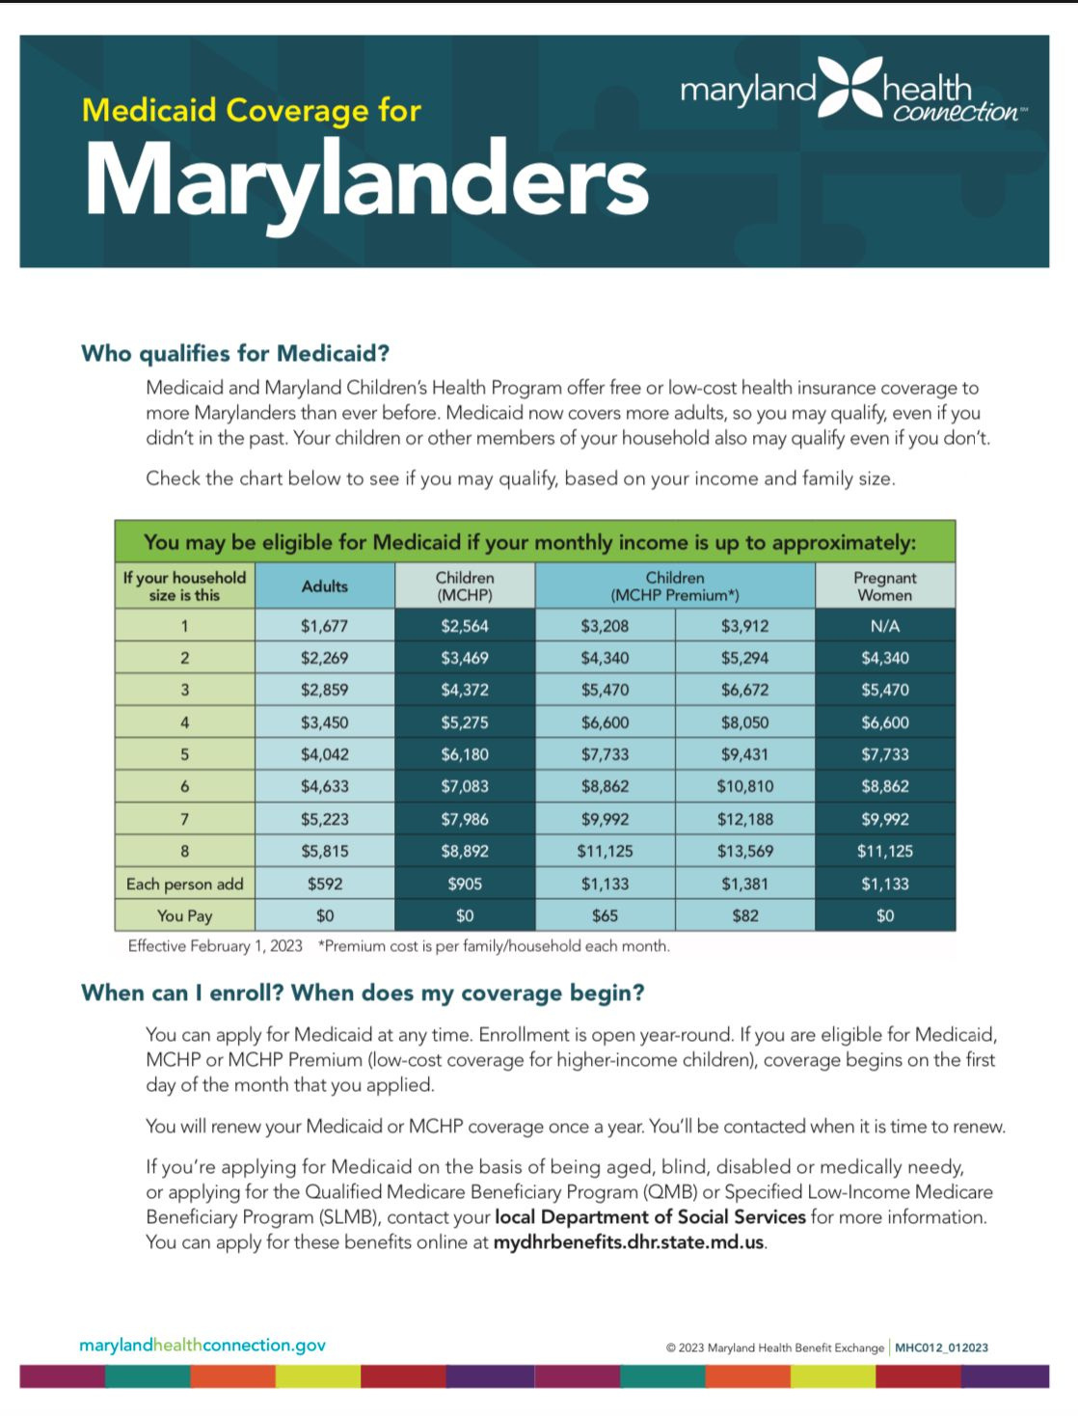

Slide 54

TO APPLY
  Online at marylandhealthconnection.gov
  By calling 1-855-642-8572
  TTY users should call 711 for Maryland Relay Service
  In person at your local Health Department or Office of Health and Human Services
  Find more information at https://health.maryland.gov/mmcp/medicaid-mch-initiatives/Pages/healthybabies.aspx

Slide 55
PARA APLICAR
  En línea en marylandhealthconnection.gov
  Llamando al 1-855-642-8572
  Los usuarios de TTY deben llamar al 711 para el servicio de retransmisión de Maryland
  En persona en el Departamento de Salud local o en la Oficina de Salud y Servicios Humanos
  Encuentre más información en https://health.maryland.gov/mmcp/medicaid-mch-initiatives/Pages/healthybabies.aspx

Slide 56

“I RECEIVED MY HEALTH INSURANCE, WHAT DO I DO?”

Slide 57
“RECIBÍ MI SEGURO MÉDICO, ¿QUÉ HAGO?”

Slide 58
https://www.marylandhealthconnection.gov
Notes:
¿Qué es una Organización de Atención Administrada (MCO)?
Una Organización de Atención Administrada (MCO) es un plan de salud o una compañía de atención médica que utiliza la atención administrada como modelo para mantener alta la calidad de la atención y al mismo tiempo limitar los costos.
Como parte de un sistema de atención administrada, una MCO acepta ofrecer sus servicios a un costo reducido, junto con otras MCO de la red.
Hay cuatro tipos de organizaciones o planes de atención administrada:
Organización de proveedores preferidos (PPO)
Organización de mantenimiento de la salud (HMO)
Punto de servicio (POS)
Organización de proveedores exclusivos (EPO)

Slide 59

ADDITIONAL SUPPORT
Notes:
Postpartum Support International
Fatherhood Program (Alex)
Diaper Assistance
Pregnancy Centers

Slide 60
  APOYO ADICIONAL
Notes:
Postpartum Support International
Fatherhood Program (Alex)
Diaper Assistance
Pregnancy Centers

Slide 61

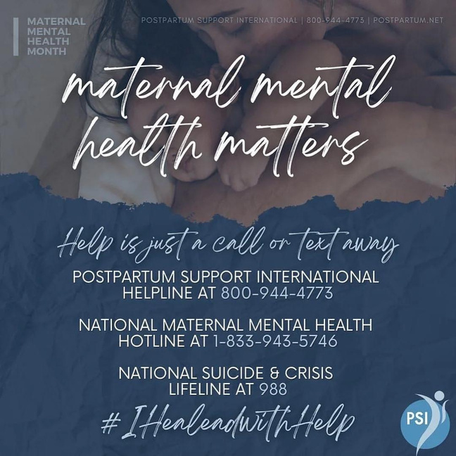
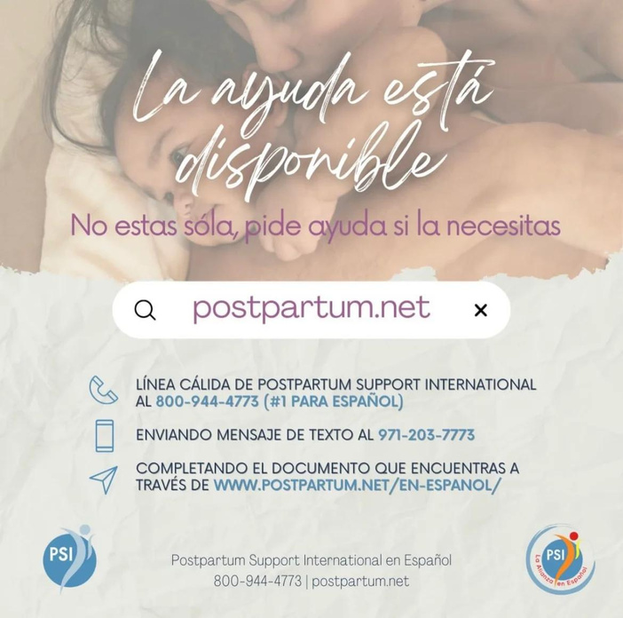
Mental Health
Postpartum Support International (PSI)
The mission of Postpartum Support International is to promote awareness, prevention and treatment of mental health issues related to childbearing in every country worldwide. PSI provides free information on their website about different maternal health mental health challenges; support groups held via zoom for different stages of perinatal scenarios; chat experts for moms and dads; & more. To learn more visit: https://www.postpartum.net/ or call 1-800-944-4773

Slide 62
Salud Mental
Apoyo posparto internacional (PSI)
La misión de Postpartum Support International es promover la concientización, la prevención y el tratamiento de los problemas de salud mental relacionados con la maternidad en todos los países del mundo. PSI proporciona información gratuita en su sitio web sobre diferentes desafíos de salud mental de la salud materna; grupos de apoyo realizados vía zoom para diferentes etapas de escenarios perinatales; expertos en chat para mamás y papás; & más. Para obtener más información, visite: https://www.postpartum.net/ o llame al 1-800-944-4773

Slide 63
Mental Health
Pro Bono Counseling
Pro Bono Counseling is a non-profit 501(c)(3) corporation founded with the goal of connecting uninsured and under-insured low-income Marylanders with compassionate and qualified mental health professionals who provide care on a volunteer basis at no cost.
To learn more visit: https://www.probonocounseling.org or call 410.825.1001.

Slide 64
Salud Mental
Pro Bono Counseling
Pro Bono Counseling es una corporación 501(c)(3) sin fines de lucro fundada con el objetivo de conectar a los residentes de Maryland de bajos ingresos, sin seguro o con seguro insuficiente, con profesionales de salud mental compasivos y calificados que brindan atención de forma voluntaria y sin costo.Para obtener más información, visite: https://www.probonocounseling.org o llame al 410.825.1001.

Slide 65
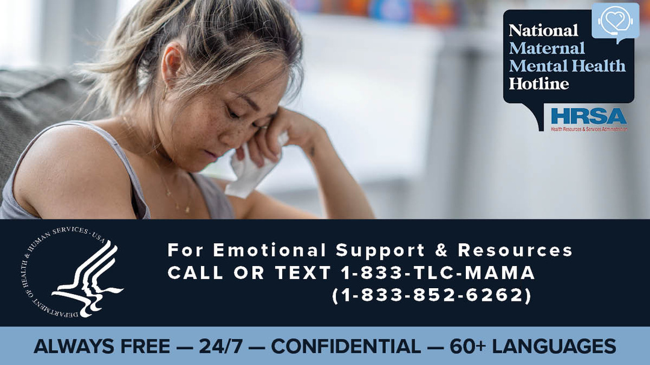
Mental Health
National Maternal Mental Health Hotline
Provides 24/7, free, confidential support, resources and referrals to any pregnant and postpartum mothers facing mental health challenges and their loved ones. The service is available via phone and text in English or Spanish. Help through interpreters is available in over 60 languages. To learn more visit: https://mchb.hrsa.gov/national-maternal-mental-health-hotline/faq or call 1-833-TLC-MAMA (1-833-852-6262).

Slide 66
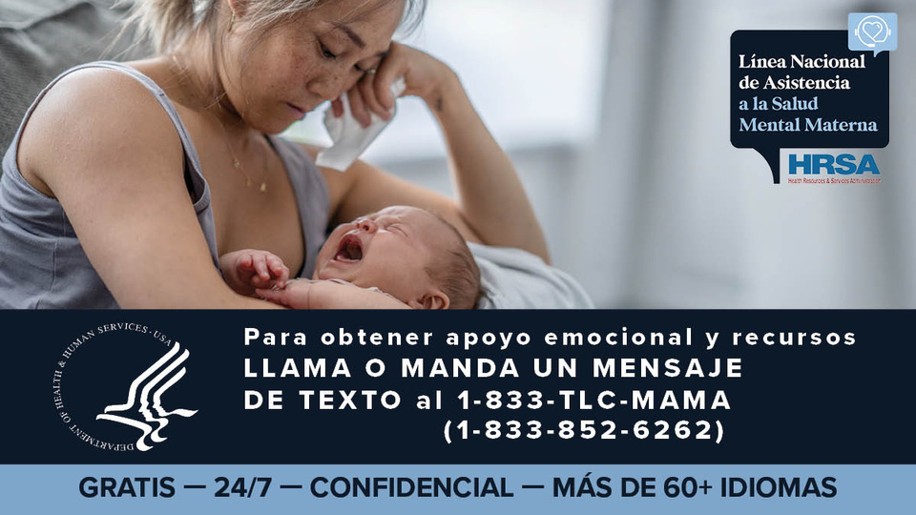
Salud Mental
Línea directa nacional de salud mental materna
Proporciona apoyo, recursos y referencias confidenciales y gratuitas las 24 horas del día, los 7 días de la semana, a cualquier madre embarazada y en posparto que enfrente problemas de salud mental y a sus seres queridos. El servicio está disponible por teléfono y mensaje de texto en inglés o español. La ayuda a través de intérpretes está disponible en más de 60 idiomas. Para obtener más información, visite: https://mchb.hrsa.gov/national-maternal-mental-health-hotline/faq o llame al 1-833-TLC-MAMA (1-833-852-6262).

Slide 67

Mental Health
Roberta‘s House
Roberta’s House provides trauma-informed care and addresses grief as a public health service. The programs are led by licensed professionals and trained volunteers who understand the impact of grief. The program offers mental health services to children, adults, and families ages five and above. Therapeutic services are available as an individual, couple, family, and grief group therapy. The programs accept Maryland Medicaid, Care First Blue Cross Blue Shield, and offer free and sliding scale payments to qualified individuals and families. To learn more visit: https://robertashouse.org/contact/ , Baltimore location: 410-235-6633, Prince George location: 301-880-5100

Slide 68
Salud Mental
Roberta’s House
Roberta's House brinda atención informada sobre el trauma y aborda el duelo como un servicio de salud pública. Los programas están dirigidos por profesionales autorizados y voluntarios capacitados que comprenden el impacto del duelo. El programa ofrece servicios de salud mental a niños, adultos y familias de cinco años o más. Los servicios terapéuticos están disponibles como terapia individual, de pareja, familiar y de grupo para el duelo. Los programas aceptan Maryland Medicaid, Care First Blue Cross Blue Shield y ofrecen pagos gratuitos y de escala móvil a personas y familias calificadas. Para obtener más información, visite: https://robertashouse.org/contact/, ubicación en Baltimore: 410-235-6633, ubicación en Prince George: 301-880-5100

Slide 69
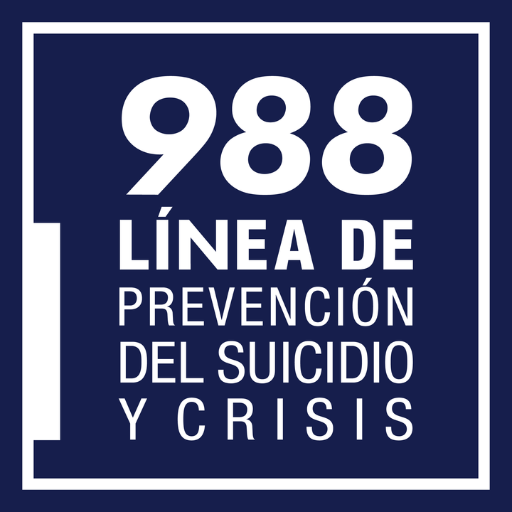
Mental Health
988
The 988 Lifeline is a national network of local crisis centers that provides free and confidential emotional support to people in suicidal crisis or emotional distress 24 hours a day, 7 days a week in the United States. They are committed to improving crisis services and advancing suicide prevention by empowering individuals, advancing professional best practices, and building awareness. To learn more visit: https://988lifeline.org

Slide 70
Salud Mental
988
988 Lifeline es una red nacional de centros de crisis locales que brinda apoyo emocional gratuito y confidencial a personas en crisis suicidas o angustia emocional las 24 horas del día, los 7 días de la semana en los Estados Unidos. Están comprometidos a mejorar los servicios de crisis y promover la prevención del suicidio empoderando a las personas, promoviendo las mejores prácticas profesionales y creando conciencia. Para obtener más información, visite: https://988lifeline.org

Slide 71
The Maryland Network Against Domestic Violence
  The Maryland Network Against Domestic Violence is the state domestic violence coalition that brings together victim service providers, allied professionals, and concerned individuals for the common purpose of reducing intimate partner and family violence and its harmful effects on [people.]
    Services and information provided Include: legal advocacy, shelter and housing support, safety planning, counseling, and more.
  To learn more visit: https://www.mnadv.org/get-help/domestic-violence-service-providers/
    Anne Arundel: 410-222-6800
    Baltimore: 410-285-4357 or 410-377-8111
    Baltimore City: 410-889-7884
    Frederick: 301-662-8800
    Howard: 410-997-2272
    Montgomery: 240-777-4000
    Prince George: 301-731-1203
Notes:
What is domestic violence?
A1. Domestic violence is a pattern of behavior when one intimate partner or spouse threatens or abuses the other partner. Abuse may include physical harm, forced sexual relations, emotional manipulation (including isolation or intimidation), and economic and/or immigration-related threats. While most recorded incidents of domestic violence involve men abusing women or children, men can also be victims of domestic violence.
Domestic violence may include sexual assault, child abuse and other violent crimes. Sexual assault is any type of sexual activity that you do not agree to, even with your spouse, and can be committed by anyone. Child abuse includes: physical abuse (any injury that does not happen by accident, including excessive punishment), physical neglect (failure to provide food, shelter, medical care or supervision), sexual abuse, and emotional abuse (threats, withholding love, support or guidance).
Under all circumstances, domestic violence, sexual assault and child abuse are illegal in the United States. All people in the United States (regardless of race, color, religion, sex, age, ethnicity, national origin or immigration status) are guaranteed protection from abuse under the law. Any victim of domestic violence – regardless of immigration or citizenship status – can seek help. An immigrant victim of domestic violence may also be eligible for immigration related protections.

Slide 72
La Red de Maryland Contra la Violencia Doméstica
  La Red de Maryland contra la Violencia Doméstica es la coalición estatal contra la violencia doméstica que reúne a proveedores de servicios para víctimas, profesionales aliados e individuos preocupados con el propósito común de reducir la violencia familiar y de pareja y sus efectos nocivos en [las personas].
    Los servicios y la información proporcionados incluyen: defensa legal, apoyo para refugio y vivienda, planificación de seguridad, asesoramiento y más.
  Para obtener más información, visite: https://www.mnadv.org/get-help/domestic-violence-service-providers/
    Anne Arundel: 410-222-6800
    Baltimore: 410-285-4357 o 410-377-8111
    Ciudad de Baltimore: 410-889-7884
    Federico: 301-662-8800
    Howard: 410-997-2272
    Montgomery: 240-777-4000
    Príncipe Jorge: 301-731-1203
Notes:
What is domestic violence?
A1. Domestic violence is a pattern of behavior when one intimate partner or spouse threatens or abuses the other partner. Abuse may include physical harm, forced sexual relations, emotional manipulation (including isolation or intimidation), and economic and/or immigration-related threats. While most recorded incidents of domestic violence involve men abusing women or children, men can also be victims of domestic violence.
Domestic violence may include sexual assault, child abuse and other violent crimes. Sexual assault is any type of sexual activity that you do not agree to, even with your spouse, and can be committed by anyone. Child abuse includes: physical abuse (any injury that does not happen by accident, including excessive punishment), physical neglect (failure to provide food, shelter, medical care or supervision), sexual abuse, and emotional abuse (threats, withholding love, support or guidance).
Under all circumstances, domestic violence, sexual assault and child abuse are illegal in the United States. All people in the United States (regardless of race, color, religion, sex, age, ethnicity, national origin or immigration status) are guaranteed protection from abuse under the law. Any victim of domestic violence – regardless of immigration or citizenship status – can seek help. An immigrant victim of domestic violence may also be eligible for immigration related protections.

Slide 73
Immigrants Experiencing Domestic Violence
  If I am a victim of domestic violence, sexual assault or other crime, what immigration options are available to me?
    There are many ways immigrants who become victims of domestic violence, sexual assault and some other specific crimes may apply for legal immigration status for themselves and their child(ren). A victim’s application is confidential and no one, including an abuser, crime perpetrator or family member, will be told that you applied.
    These immigration benefits each have specific requirements that must be established. Consult an immigration lawyer who works with victims of domestic violence to discuss how any of these immigration benefits may affect or assist you.
  Organizations in Maryland providing legal assistance are nonprofits like:
    Ayuda (Maryland and DC) - Maryland Phone Number: (240) 594-0600
    Mil Mujeres (Across the United States, including a DC office): 202-560-5237
  Help and support is available to victims of domestic violence through the National Domestic Violence Hotline at 800-799-SAFE (7233) or 800-787-3224 (TTY).
Notes:
What are the legal rights for victims of domestic violence in the United States?
All people in the United States, regardless of immigration or citizenship status, are guaranteed basic protections under both civil and criminal law. Laws governing families provide you with:
The right to obtain a protection order for you and your child(ren).
The right to legal separation or divorce without the consent of your spouse.
The right to share certain marital property. In cases of divorce, the court will divide any property or financial assets you and your spouse have together.
The right to ask for custody of your child(ren) and financial support. Parents of children under the age of 21 often are required to pay child support for any child not living with them.
--
If I am a victim of domestic violence, sexual assault or other crime, what immigration options are available to me?
There are many ways immigrants who become victims of domestic violence, sexual assault and some other specific crimes may apply for legal immigration status for themselves and their child(ren). A victim’s application is confidential and no one, including an abuser, crime perpetrator or family member, will be told that you applied.
Self-petitions for legal status under the Violence Against Women Act (VAWA)
Cancellation of removal under VAWA
U-nonimmigrant status (crime victims)
These immigration benefits each have specific requirements that must be established. Consult an immigration lawyer who works with victims of domestic violence to discuss how any of these immigration benefits may affect or assist you.
Organizations in Maryland providing legal assistance are nonprofits Ayuda, Mil Mujeres, and many more.
Help and support is available to victims of domestic violence through the National Domestic Violence Hotline at 800-799-SAFE (7233) or 800-787-3224 (TTY).

Slide 74
Inmigrantes que Sufren Violencia Doméstica
  Si soy víctima de violencia doméstica, agresión sexual u otro delito, ¿qué opciones de inmigración tengo disponibles?
    Hay muchas maneras en que los inmigrantes que se convierten en víctimas de violencia doméstica, agresión sexual y algunos otros delitos específicos pueden solicitar un estatus migratorio legal para ellos y sus hijos. La solicitud de una víctima es confidencial y a nadie, ni siquiera a un abusador, un perpetrador de un delito o un miembro de su familia, se le informará que usted presentó su solicitud.
    Cada uno de estos beneficios de inmigración tiene requisitos específicos que deben establecerse. Consulte a un abogado de inmigración que trabaje con víctimas de violencia doméstica para analizar cómo cualquiera de estos beneficios de inmigración puede afectarlo o ayudarlo.
  Las organizaciones en Maryland que brindan asistencia legal son organizaciones sin fines de lucro como:
    Ayuda (Maryland y DC) - Número de teléfono de Maryland: (240) 594-0600
    Mil Mujeres (en todo Estados Unidos, incluida una oficina en DC): 202-560-5237
  Hay ayuda y apoyo disponibles para las víctimas de violencia doméstica a través de la Línea Directa Nacional contra la Violencia Doméstica al 800-799-SAFE (7233) o 800-787-3224 (TTY).
Notes:
What are the legal rights for victims of domestic violence in the United States?
All people in the United States, regardless of immigration or citizenship status, are guaranteed basic protections under both civil and criminal law. Laws governing families provide you with:
The right to obtain a protection order for you and your child(ren).
The right to legal separation or divorce without the consent of your spouse.
The right to share certain marital property. In cases of divorce, the court will divide any property or financial assets you and your spouse have together.
The right to ask for custody of your child(ren) and financial support. Parents of children under the age of 21 often are required to pay child support for any child not living with them.
--
If I am a victim of domestic violence, sexual assault or other crime, what immigration options are available to me?
There are many ways immigrants who become victims of domestic violence, sexual assault and some other specific crimes may apply for legal immigration status for themselves and their child(ren). A victim’s application is confidential and no one, including an abuser, crime perpetrator or family member, will be told that you applied.
Self-petitions for legal status under the Violence Against Women Act (VAWA)
Cancellation of removal under VAWA
U-nonimmigrant status (crime victims)
These immigration benefits each have specific requirements that must be established. Consult an immigration lawyer who works with victims of domestic violence to discuss how any of these immigration benefits may affect or assist you.
Organizations in Maryland providing legal assistance are nonprofits Ayuda, Mil Mujeres, and many more.
Help and support is available to victims of domestic violence through the National Domestic Violence Hotline at 800-799-SAFE (7233) or 800-787-3224 (TTY).

Slide 75
UMD Safe Center for Human Trafficking Survivors
  The University of Maryland SUPPORT, ADVOCACY, FREEDOM, AND EMPOWERMENT (SAFE) Center for Human Trafficking Survivors provides survivor-centered and trauma-informed services that empower trafficking survivors to heal and reclaim their lives. The SAFE Center aims to prevent trafficking and better serve survivors through research and policy advocacy.
  Services
    Provide direct services for survivors of sex and labor trafficking.
    Conduct research to fill gaps in knowledge on human trafficking and to improve our services to survivors.
    Promote advocacy in support of justice and empowerment for survivors.
  Target Population
    Survivors of sex and/or labor trafficking of all nationalities, ages, and genders.
  To learn more visit: https://umdsafecenter.org/ or call 301-314-7233.
    If you or someone you know is in immediate danger, please call 911.

Slide 76
Centro Seguro de la UMD para Sobrevivientes de la Trata de Personas
  El Centro de APOYO, DEFENSA, LIBERTAD Y EMPODERAMIENTO (SAFE) de la Universidad de Maryland para sobrevivientes de la trata de personas brinda servicios centrados en los sobrevivientes e informados sobre el trauma que empoderan a los sobrevivientes de la trata para sanar y recuperar sus vidas. El Centro SAFE tiene como objetivo prevenir la trata y servir mejor a los sobrevivientes a través de la investigación y la promoción de políticas.
  Servicios
    Proporcionar servicios directos para sobrevivientes de trata sexual y laboral.
    Realizar investigaciones para llenar vacíos de conocimiento sobre la trata de personas y mejorar nuestros servicios a los sobrevivientes.
    Promover la promoción en apoyo de la justicia y el empoderamiento de los sobrevivientes.
  Población objetivo
    Sobrevivientes de trata sexual y/o laboral de todas las nacionalidades, edades y géneros.
  Para obtener más información, visite: https://umdsafecenter.org/ o llame al 301-314-7233.
    Si usted o alguien que conoce está en peligro inmediato, llame al 911.

Slide 77
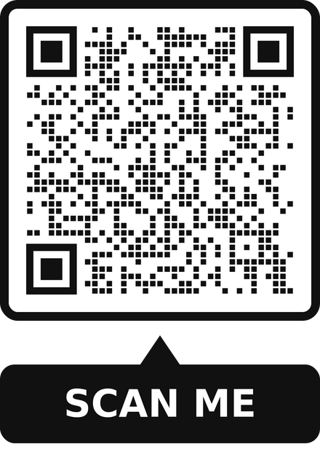
Legal Rights for Birthing People
  Every birthing person has the right to choose and change their provider at any point in time of their pregnancy and labor and delivery,
  Every birthing person has the right to having an a medical interpreter.
  Every birthing person has the right to having support during labor and birth such as a doula.
  Every birthing person have the right to breastfeed. If breastfeeding is not recommended, the provider is required to share the risks and recommendations to nourishing child.
  Every birthing person have the right to not being separated from baby. When and if separation is recommended, any risks and benefits must be explained by the healthcare provider.
  To learn more about your legal rights for birthing people please visit https://www.coachingsaludholistica.com/pregnancycoaching or scan the QR code.
Notes:
Federal Family and Medical Leave Act (FMLA)
The Family and Medical Leave Act entitles certain employees up to 12 weeks of unpaid leave for specified family and medical reasons. Below are some common questions. If you have further questions about your rights under FMLA, consult with an attorney or your employer.
Maryland's Parental Leave Act (MPLA)
Maryland’s Parental Leave Act (MPLA) requires an employer in the State of Maryland that has between 15 to 49 employees to provide eligible employees with 6 work-weeks of unpaid parental leave benefits, during any 12-month period, for the birth, adoption, or foster placement of a child. Below are some common questions. If you have further questions about your rights under MPLA, consult with an attorney or your employer.
https://www.peoples-law.org/family-medical-leave-act-and-parental-leave-act#:~:text=Maryland%27s%20Parental%20Leave%20Act%20(MPLA)%20requires%20an%20employer%20in%20the,Below%20are%20some%20common%20questions.
The Maryland Breastfeeding Law states that:
A mother may breastfeed her child in any public or private location in which the mother and child are authorized to be.
A person may not restrict or limit the right of a mother to breastfeed her child.
(Md. Code §20-801)

Slide 78
Derechos Legales para las Personas que Dan a Luz
  Toda persona que da a luz tiene derecho a elegir y cambiar de proveedor en cualquier momento del embarazo y del parto.
  Toda persona que dé a luz tiene derecho a contar con un intérprete médico.
  Toda persona que da a luz tiene derecho a contar con apoyo durante el trabajo de parto y el parto, como una doula.
  Toda persona que dé a luz tiene derecho a amamantar. Si no se recomienda la lactancia materna, el proveedor debe compartir los riesgos y recomendaciones para la alimentación del niño.
  Toda persona que da a luz tiene derecho a no ser separada del bebé. Cuando y si se recomienda la separación, el proveedor de atención médica debe explicar los riesgos y beneficios.
  Para obtener más información sobre sus derechos legales para las personas que dan a luz, visite https://www.coachingsaludholistica.com/pregnancycoaching o escanee el código QR.
Notes:
Ley Federal de Licencia Familiar y Médica (FMLA)
La Ley de Licencia Familiar y Médica otorga a ciertos empleados hasta 12 semanas de licencia no remunerada por razones familiares y médicas específicas. A continuación se presentan algunas preguntas comunes. Si tiene más preguntas sobre sus derechos según la FMLA, consulte con un abogado o su empleador.
Ley de licencia parental de Maryland (MPLA)
La Ley de Licencia Parental de Maryland (MPLA) requiere que un empleador en el Estado de Maryland que tenga entre 15 y 49 empleados proporcione a los empleados elegibles 6 semanas laborales de beneficios de licencia parental no remunerada, durante cualquier período de 12 meses, por nacimiento, adopción, o colocación de un niño en hogares de guarda. A continuación se presentan algunas preguntas comunes. Si tiene más preguntas sobre sus derechos según la MPLA, consulte con un abogado o su empleador.
https://www.peoples-law.org/family-medical-leave-act-and-parental-leave-act#:~:text=Maryland%27s%20Parental%20Leave%20Act%20(MPLA)%20requires%20an%20employer%20in%20the,Below%20are%20some%20common%20questions.
La Ley de Lactancia Materna de Maryland establece que:
Una madre podrá amamantar a su hijo en cualquier lugar público o privado en el que la madre y el niño estén autorizados a estar.
Una persona no podrá restringir ni limitar el derecho de una madre a amamantar a su hijo.
(Código de Maryland §20-801)

Slide 79
Crisis Pregnancy Centers - Avoid When Possible
  People seeking reproductive health care must have access to comprehensive, evidence-based, nonjudgmental health care and information from qualified professionals, regardless of whether they decide to continue a pregnancy or seek abortion care.
  A crisis pregnancy center, sometimes called a pregnancy resource center or a pro-life pregnancy center, is a type of nonprofit organization established by anti-abortion groups primarily to persuade pregnant women not to have an abortion.
    If you are looking to learn more about your abortion or birth control options, it Is best to avoid these centers.
  How can I spot a crisis pregnancy center?
    Look for the words “pregnancy options,” “pregnancy resource center,” or “pregnancy care center” in your internet search results, on advertisements, and on their signage.
  In short, crisis pregnancy centers:
    Will not refer you to abortion providers,
    May not give you your pregnancy test result or will delay giving it to you,
    May not give you complete information about your options,
    May not have licensed medical providers on staff,
    Advertisements may include the words “pregnancy options,” “pregnancy resource center,” or “pregnancy care center.”​

Slide 80
Family Planning Clinics or Women’s Health Clinics
  There are referral services that can direct you to reproductive health clinics (also called family planning clinics or women’s health clinics) near you that provide abortion and birth control.
    All Options: Operates a toll-free talkline to provide judgment-free support for pregnancy options, pregnancy loss, abortion, adoption, parenting, infertility, or other reproductive decisions and experiences. (Formerly known as Backline.) By phone: 1-888-493-0092
    AbortionFinder.org: A directory of trusted, verified abortion service providers in the United States. Also shares what to expect from a medication abortion versus an in-clinic abortion.​
    Northwest Abortion Access Fund: Provides referrals, fundraising counseling, and financial help to pay for abortions and related travel. By phone: 1-866-NWAAF10 (1-866-692-2310)
    Repro Legal Helpline: Free, confidential helpline where you can get legal information or advice about self-managed abortion, young people’s access to abortion or judicial bypass, and referrals to local resources.
    Run by If/When/How. By phone: 1-844-868-2812
  These clinics will provide a spectrum of services: pregnancy support and counseling, pregnancy tests, birth control, abortion counseling and procedure, resource navigation, material assistance, and more.

Slide 81

Diaper Assistance
  Locations to seek diaper assistance:
    Local church
    Women’s centers
    Department of Social Services
  Use https://greaterdcdiaperbank.org/our-programs/diaperhubs/ to find diapers for Central Maryland, DC, Northern Virginia
  Use https://greaterdcdiaperbank.org/get-help/ for all of the DMV area.

Slide 82
Asistencia para pañales
  Lugares para buscar ayuda con los pañales:
    Iglesia local
    Centros de mujeres
    Departamento de Servicios Sociales
  Utilice https://greaterdcdiaperbank.org/our-programs/diaperhubs/ para encontrar pañales para Central Maryland, DC, Northern Virginia
  Utilice https://greaterdcdiaperbank.org/get-help/ para toda el área del DMV.

Slide 83
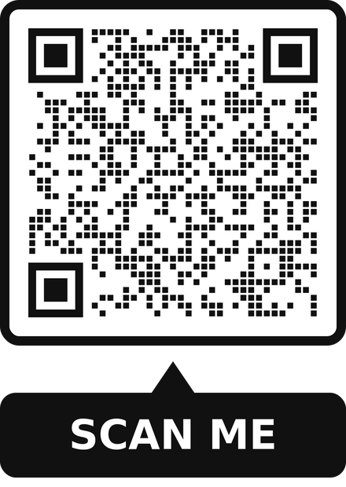
Woman, Infant, and Children (WIC)
  Whether you’re a pregnant woman, a parent, or any other guardian of a young child, Maryland WIC is here to help your little one grow up healthy and strong. WIC provides healthy supplemental foods, referrals to other programs, and support for pregnant women, new mothers, and children under age five. Over half of the infants born in the United States are on WIC.
  Maryland WIC is for you if...
    You live in Maryland
    Pregnant or New mom (up to six months after delivery)
    Breastfeeding mom (up to one year after delivery)
    Infant
    Child under the age of five
    You meet the income guidelines​​​​​
    You have a nutritional need​​​
  You Can...
    Have a job or be unemployed
    Own a home or live with friends or relatives
    Be married or single
    Be a father, mother, guardian, or grandparent and apply for benefits for an infant or child under the age of 5
Find a local WIC office!
Notes:
State WIC HOTLINE 1-800-242-4WIC

Slide 84
Mujeres, bebés y niños (WIC)
  Ya sea que sea una mujer embarazada, un padre o cualquier otro tutor de un niño pequeño, Maryland WIC está aquí para ayudar a su pequeño a crecer sano y fuerte. WIC proporciona alimentos complementarios saludables, referencias a otros programas y apoyo para mujeres embarazadas, madres primerizas y niños menores de cinco años. Más de la mitad de los bebés nacidos en los Estados Unidos reciben WIC.
  Maryland WIC es para usted si...
    vives en maryland
    Embarazada o nueva mamá (hasta seis meses después del parto)
    Mamá que amamanta (hasta un año después del parto)
    Niño
    Niño menor de cinco años
    Cumples con las pautas de ingresos
    Tienes una necesidad nutricional
  Puede...
    Tener un trabajo o estar desempleado
    Ser propietario de una casa o vivir con amigos o familiares
    Estar casado o soltero
    Ser padre, madre, tutor o abuelo y solicitar beneficios para un infante o niño menor de 5 años
¡Encuentre una oficina local de WIC!
Notes:
State WIC HOTLINE 1-800-242-4WIC

Slide 85
Early Head Start Programs
  Early Head Start (EHS) programs serve infants and toddlers under the age of 3, and pregnant women. EHS programs provide intensive comprehensive child development and family support services to low-income infants and toddlers and their families, and to pregnant women and their families.
  Early Head Start programs provide similar services as preschool Head Start programs, but they are tailored for the unique needs of infants and toddlers. Early Head Start programs promote the physical, cognitive, social, and emotional development of infants and toddlers through safe and developmentally enriching caregiving. This prepares these children for continued growth and development and eventual success in school and life.
  To locate the early head start program closest to you visit: https://eclkc.ohs.acf.hhs.gov/center-locator
Notes:
Early Head Start (EHS) programs serve infants and toddlers under the age of 3, and pregnant women. EHS programs provide intensive comprehensive child development and family support services to low-income infants and toddlers and their families, and to pregnant women and their families.
Early Head Start programs provide similar services as preschool Head Start programs, but they are tailored for the unique needs of infants and toddlers. Early Head Start programs promote the physical, cognitive, social, and emotional development of infants and toddlers through safe and developmentally enriching caregiving. This prepares these children for continued growth and development and eventual success in school and life.
Following the general Head Start model, Early Head Start programs support parents, both mothers and fathers, in their role as primary caregivers and teachers of their children. Programs assist families in meeting their own personal goals and achieving self-sufficiency across a wide variety of domains, such as housing stability, continued education, and financial security.
Early Head Start programs also mobilize the local community to provide the resources and environment necessary to ensure a comprehensive, integrated array of services and support for children and families.

Slide 86
Programas de Head Start Temprano
  Los programas Early Head Start (EHS) atienden a bebés y niños pequeños menores de 3 años y a mujeres embarazadas. Los programas de EHS brindan servicios intensivos integrales de desarrollo infantil y apoyo familiar a bebés y niños pequeños de bajos ingresos y sus familias, y a mujeres embarazadas y sus familias.
  Los programas Early Head Start brindan servicios similares a los programas preescolares Head Start, pero están diseñados para las necesidades únicas de los bebés y niños pequeños. Los programas Early Head Start promueven el desarrollo físico, cognitivo, social y emocional de bebés y niños pequeños a través de un cuidado seguro y enriquecedor para el desarrollo. Esto prepara a estos niños para un crecimiento y desarrollo continuos y un eventual éxito en la escuela y la vida.
  Para localizar el programa Early Head Start más cercano a usted,
visite: https://eclkc.ohs.acf.hhs.gov/center-locator
Notes:
Los programas Early Head Start (EHS) atienden a bebés y niños pequeños menores de 3 años y a mujeres embarazadas. Los programas de EHS brindan servicios intensivos integrales de desarrollo infantil y apoyo familiar a bebés y niños pequeños de bajos ingresos y sus familias, y a mujeres embarazadas y sus familias.
Los programas Early Head Start brindan servicios similares a los programas preescolares Head Start, pero están diseñados para las necesidades únicas de los bebés y niños pequeños. Los programas Early Head Start promueven el desarrollo físico, cognitivo, social y emocional de bebés y niños pequeños a través de un cuidado seguro y enriquecedor para el desarrollo. Esto prepara a estos niños para un crecimiento y desarrollo continuos y un eventual éxito en la escuela y la vida.
Siguiendo el modelo general de Head Start, los programas Early Head Start apoyan a los padres, tanto madres como padres, en su papel de cuidadores principales y maestros de sus hijos. Los programas ayudan a las familias a alcanzar sus propios objetivos personales y lograr la autosuficiencia en una amplia variedad de ámbitos, como estabilidad de vivienda, educación continua y seguridad financiera.
Los programas Early Head Start también movilizan a la comunidad local para proporcionar los recursos y el entorno necesarios para garantizar una gama integral e integrada de servicios y apoyo para niños y familias.

Slide 87
Maryland Childcare Assistance
  The Child Care Scholarship (CCS) (formerly known as Child Care Subsidy) program helps eligible families in Maryland pay for high-quality child care and early education programs.
  NOTE: Parents ARE NOT required to be citizens of the United States.
  If eligible, Scholarships are available for:
    A child who is younger than 13, or
    An individual 13-19 years old who has a qualifying disability.​
  There are three kinds of scholarships:
    Temporary scholarship -- a 60-day scholarship that can be used for care provided by a Maryland registered family home or Maryland licensed child care center
    Full, formal scholarship -- can be used for care provided by a Maryland registered family home or Maryland licensed child care center
    Informal scholarship -- can be used for care provided by a relative in the relative’s home or child’s home and a non-relative in the child’s home.
  To apply for a Child Care Scholarship, you must submit an application through the Child Care Scholarship Family Web Portal on the Maryland State Department of Education website: money4childcare.com
    For additional help, you can contact a Family Resource Specialist by calling 1.877.261.0060 8:30am–4pm,Monday– Friday EST.
Notes:
To be eligible for the CCS Program, you must be:
A Maryland resident who is working/employed, in an approved training program or attending school. For families where both parents live within the same household, both parents must meet all eligibility requirements.
A recipient of Temporary Cash Assistance (TCA) or Supplemental Security Income (SSI) or within CCS income guidelines (see below).
Willing to have your child immunized to Maryland state standards or provide documentation supporting Exemption from Immunization.
Willing to provide proof that each child needing child care is a citizen of the United States or a qualified alien. (Provide a Birth Certificate for each child or documentation that certifies the child's status.)
NOTE: Parents ARE NOT required to be citizens of the United States.
Willing to provide proof of identity for all members within the household composition. (Proof of identity for the parent can be any form of a government issued document. The birth certificate or immigration status documentation can serve as proof of identity for each child in the household composition.)
Willing to provide a Photo I.D. (Only required of the head of households.)

Slide 88
Asistencia de cuidado infantil de Maryland
  El programa Child Care Scholarship (CCS) (anteriormente conocido como Child Care Subsidy) ayuda a las familias elegibles en Maryland a pagar programas de educación temprana y cuidado infantil de alta calidad.
  NOTA: NO se requiere que los padres sean ciudadanos de los Estados Unidos.
  Si es elegible, hay becas disponibles para:
    Un niño menor de 13 años, o
    Una persona de 13 a 19 años que tiene una discapacidad calificada.
  Hay tres tipos de becas:
    Beca temporal: una beca de 60 días que se puede utilizar para el cuidado brindado por un hogar familiar registrado en Maryland o un centro de cuidado infantil con licencia de Maryland.
    Beca formal completa: se puede utilizar para el cuidado brindado por un hogar familiar registrado en Maryland o un centro de cuidado infantil con licencia de Maryland.
    Beca informal: puede utilizarse para el cuidado proporcionado por un familiar en el hogar del familiar o en el hogar del niño y por un no familiar en el hogar del niño.
  Para solicitar una beca de cuidado infantil, debe enviar una solicitud a través del portal web familiar de becas de cuidado infantil en el sitio web del Departamento de Educación del Estado de Maryland: money4childcare.com
    Para obtener ayuda adicional, puede comunicarse con un especialista en recursos familiares llamando al 1.877.261.0060, de 8:30 a. m. a 4 p. m., de lunes a viernes, hora del Este.
Notes:
Para ser elegible para el Programa CCS, debe ser:
Un residente de Maryland que esté trabajando/empleado, en un programa de capacitación aprobado o asistiendo a la escuela. Para familias donde ambos padres viven en el mismo hogar, ambos padres deben cumplir con todos los requisitos de elegibilidad.
Un beneficiario de Asistencia Temporal en Efectivo (TCA) o Ingreso de Seguridad Suplementario (SSI) o dentro de las pautas de ingresos de CCS (ver a continuación).
Estar dispuesto a vacunar a su hijo según los estándares del estado de Maryland o proporcionar documentación que respalde la exención de vacunación.
Estar dispuesto a proporcionar prueba de que cada niño que necesita cuidado infantil es ciudadano de los Estados Unidos o extranjero calificado. (Aportar Acta de Nacimiento de cada niño o documentación que acredite el estado del niño.)
NOTA: NO se requiere que los padres sean ciudadanos de los Estados Unidos.
Estar dispuesto a proporcionar prueba de identidad para todos los miembros dentro de la composición del hogar. (La prueba de identidad de los padres puede ser cualquier forma de documento emitido por el gobierno. El certificado de nacimiento o la documentación del estado migratorio pueden servir como prueba de identidad para cada niño en la composición del hogar).
Dispuesto a proporcionar una identificación con fotografía. (Sólo se requiere del jefe de hogar.)

Slide 89
RESOURCES
RECURSOS
Follow Us Online!
Let's connect for our latest news and updates on resources and events.
Twitter @cshmd_
Facebook @coachingsaludholistica
Instagram @coachingsaludholistica
LinkedIn Coaching Salud Holistica
TikTok @coachingsaludholistica
OPEN YOUR PHONE CAMERA AND SCAN THIS QR CODE.
ABRE LA CÁMARA DE TU TELÉFONO Y ESCANEA ESTE CÓDIGO QR.
Spotify Coaching Salud Holistica
Email: jhoselyn@coachingsaludholistica.org
Website: www.coachingsaludholistica.com

Slide 90
RESOURCES
RECURSOS
¡Síguenos en línea!
Conectémonos para nuestras últimas noticias y actualizaciones de recursos y eventos.
Twitter @cshmd_
Facebook @coachingsaludholistica
Instagram @coachingsaludholistica
LinkedIn Coaching Salud Holistica
OPEN YOUR PHONE CAMERA AND SCAN THIS QR CODE.
ABRE LA CÁMARA DE TU TELÉFONO Y ESCANEA ESTE CÓDIGO QR.
TikTok @coachingsaludholistica
Spotify Coaching Salud Holistica
Correo Electrónico: jhoselyn@coachingsaludholistica.org
Sito Web: www.coachingsaludholistica.com

